Slide 1
Retail-Giant Sales Forecasting Assignment
Presented By : Harshal Gawale

Slide 2
Background – Time Series Assignment
“Global Mart” is an online store super giant having worldwide operations. It takes orders and delivers across the globe and deals with all the major product categories - consumer, corporate & home office.
Now, the store wants to finalise the inventory management plan for the next 6 months. Hence, the
objectives of the analysis are:
Find out the most profitable (and consistent) market segments for the company.
For these segments, forecast the sales and the demand for the next 6 months, so that the revenue
and inventory may be managed accordingly
The analysis has been divided into follo. parts:
Data Understanding
Finding the most profitable segments
Forecasting sales and demand for each of the profitable segments

Slide 3
Problem solving methodology
Data Preparation | Modeling | Model Evaluation | Forecasting
Create 21 Market- Segment buckets | Create time series of top Aggregated Data | Evaluate model on validation set using MPSE | Use best model to forecast future 6 months Sales.
Aggregate buckets by Sales, Profit, Quantity | Smoothen time series to identify trend & seasonality | Choose best model out of Model 1 & Model 2 using MPSE | Repeat same for both Market-Segments separately for Sales & Quantity
Calculate Coefficient of Variation(CV | Creating train & validation sets of size 42 & 6 months | For Auto ARIMA plot ACF of residuals to check it resembles white noise | Prepare 4 forecasts for top 2 segments by Sales & Quantity
Pick Top 2 Segments based on CV & Profit | Build Model 1: Regression Model
Aggregate data by Market-Segment & Order Month on subset of Top 2 segments | Build Model 2: Auto ARMA Model

Slide 5

Analysis: Data Preparation & EDA
Created 21 data subset buckets based on Market & Segment they belong.
Aggregated data in each bucket by Sales, Quantity & Profit.
Calculated Coefficient of Variation(CV) using aggregated Profit for each Market-Segment
using below:
CV = sd(Profit)*100/mean(Profit)
Using CV & Profit found Top 2 most profitable Market-Segments as APAC_Consumer &
EU_Consumer with below values:
5. Aggregated data by Market-Segment & Order Month.

Slide 6
Analysis: Building Regression and Auto ARIMA Models
Created time series for aggregated data of EU_Consumer & APAC_Consumer subsets for first 48
months:
ts(APAC_Consumer_Agg$Sales,frequency=12,start=c(2011,1),end=c(2014,12))
Smoothened time series using Moving Average method, also tested Holt Winters smoothing.
Time series data was divided into train(1-42 month), validation(43-48 month) & test sets(49-54 month).
Model 1: Linear model : Created using tslm() function from forecast package in R on train data.
Model 2: Auto Arima Model: Created using auto.arima() function from forecast package in R train
data
Both models were evaluated using Mean Absolute Percentage Error(MAPE).
ACF plots of residuals were used check that it resembles white noise.

Slide 7
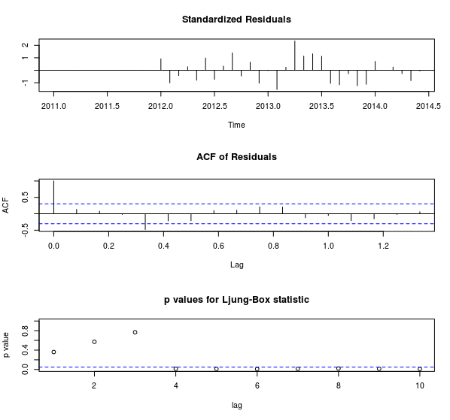
Analysis: Model Evaluation
a)MAPE and other measures for APAC
Consumer time series Linear Model
b)MAPE and other measures for APAC Consumer time series Auto ARIMA Model
c) ACF of Residuals for APAC Consumer Sales time series

Slide 8
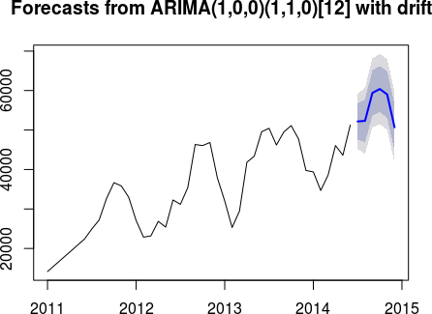
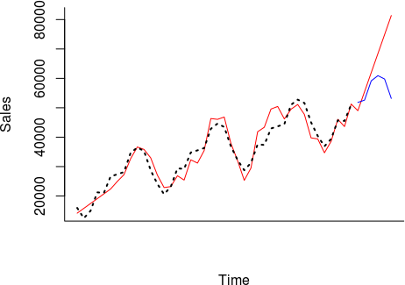
Results: 1a. APAC Consumer Sales Forecast on validation set
a) Linear Model Forecast
b) Auto ARIMA Model Forecast

Slide 9
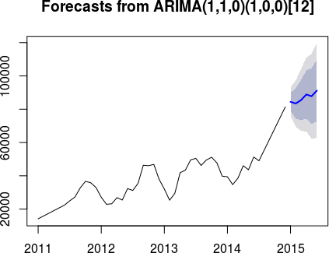
Results: 1b. APAC Consumer Sales Forecast on test set
a) ) Auto ARIMA Model Forecast

Slide 10
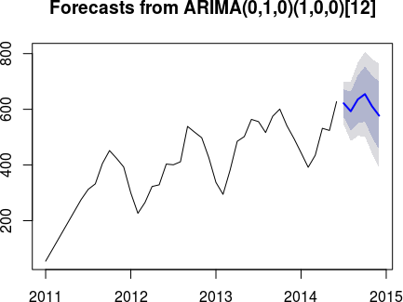
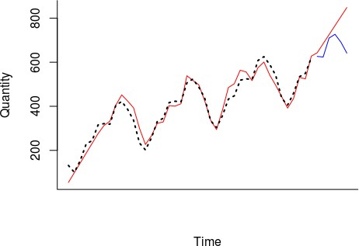
Results: 2a. APAC Consumer Quantity Forecast on validation set
a) Linear Model Forecast
b) Auto ARIMA Model Forecast

Slide 11
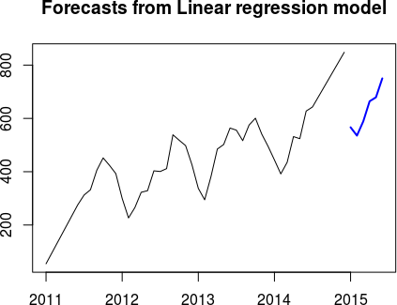
Results: 2b. APAC Consumer Quantity Forecast on test set
a) Linear Model Forecast

Slide 12
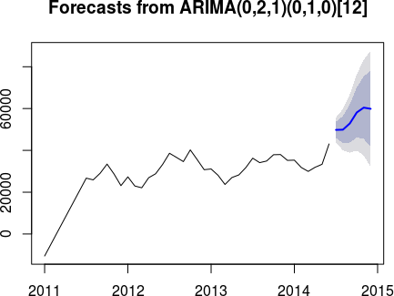
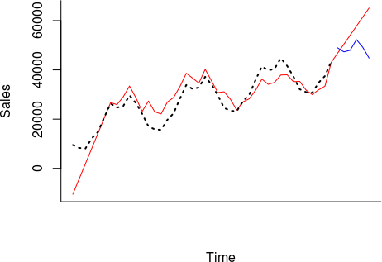
Results: 3a. EU Consumer Sales Forecast on validation set
a) Linear Model Forecast
b) Auto ARIMA Model Forecast

Slide 13
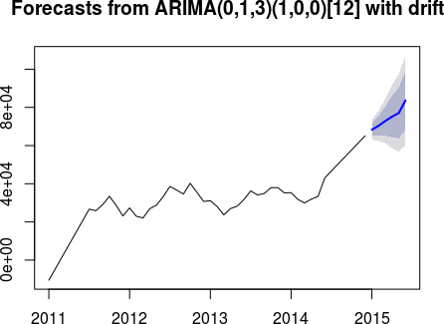
Results: 3b. EU Consumer Sales Forecast on test set
a) ) Auto ARIMA Model Forecast

Slide 14
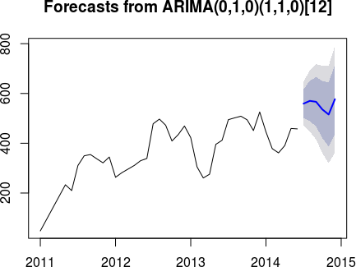
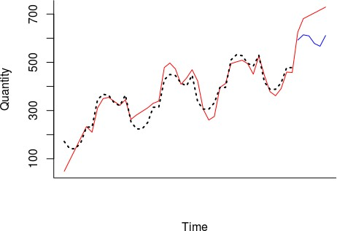
Results: 4a. EU Consumer Quantity Forecast on validation set
a) Linear Model Forecast
b) Auto ARIMA Model Forecast

Slide 15
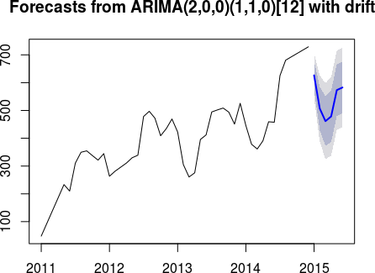
Results: 4b. EU Consumer Quantity Forecast on validation set
a) ) Auto ARIMA Model Forecast

Slide 16

Conclusions
Based on data provided we helped “Global Mart” in identifying 2 most profitable market segments as APAC Consumer and EU Consumer.
We created total 8 forecasting models for top 2 segments out of which 4 best were selected for forecasting future 6 months sales & quantity for months January 2015 to June 2015.
Below is summary of 4 key forecasts on test data(Jan – June 2015):
APAC Consumer Sales is likely to rise in next 6 months with small
fluctuations.
APAC Consumer is also likely to rise steeply in coming 6 months.
EU Consumer Sales may show slow rise in coming months.
EU Consumer Quantity is likely to drop during initial 1 or 2 months & then
rise rapidly in next 3 months, eventually reaching a plateau.

